Slide 1
PEPP Trajectories Updates
Wed. July 9, 2025
1

Slide 2
Goals:
Identify meaningful, distinct trajectories of depressive and negative symptoms
Identify neuroanatomical characteristics associated with trajectory membership
2

Slide 3
Which data to use to create trajectories?
Total CDSS
Total SANS
LV1 (composite depression score)
LV2 (SANS minus alogia)
LV3 (guilt and early wakening)
3

Slide 4
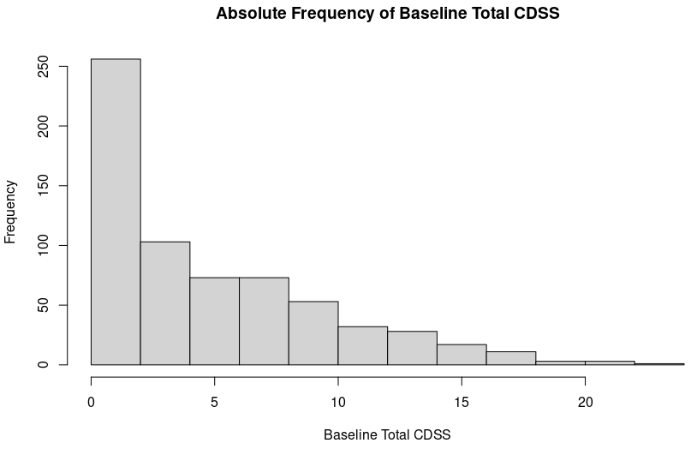
Mean: 5.1 Median: 4 Range: 0-23. 136 out of 653= 0 (21%)
4

Slide 5
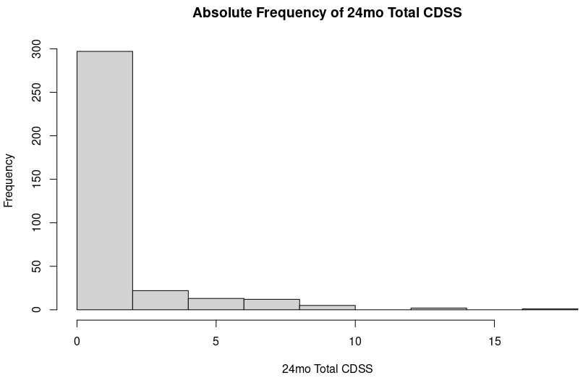
Mean: 1.2 Median: 0 Range: 0-17. 212 out of 331 = 0 (64%)
5
Notes:
4 people that stay at 0 from baseline to 24 months

Slide 6
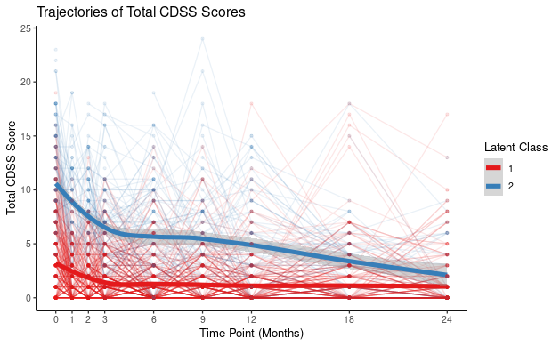
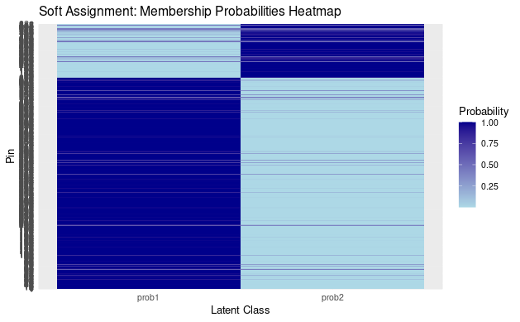
LCGA2:
BIC: 20853
Class 1: 80% Class 2: 20%
LCGA - Total CDSS
6

Slide 7
LCGA2:
BIC: 20853
Class 1: 80% Class 2: 20%
LCGA - Total CDSS
Imaging data:
Class 1: 106 (84%)
Class 2: 21 (16%)
7

Slide 8
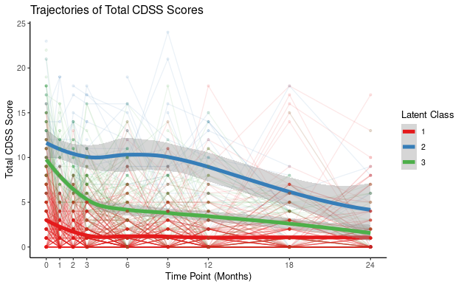
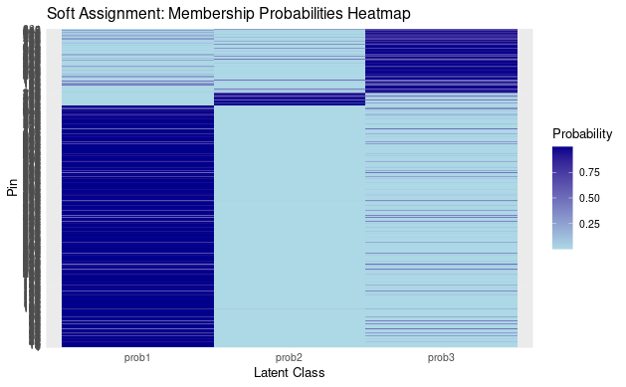
LCGA3:
BIC: 20744
Class 1: 76% Class 2: 4% Class 3: 20%
LCGA - Total CDSS
8

Slide 9
LCGA3:
BIC: 20744
Class 1: 76% Class 2: 4% Class 3: 20%
LCGA - Total CDSS
Imaging data:
Class 1: 100 (79%)
Class 2: 2 (1%)
Class 3: 25 (20%)
9

Slide 10
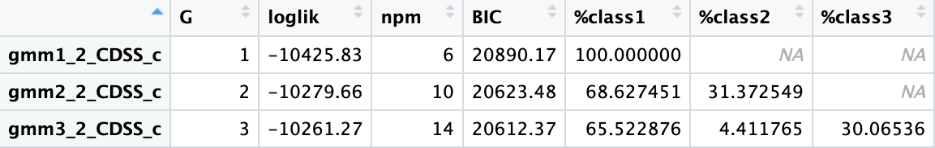
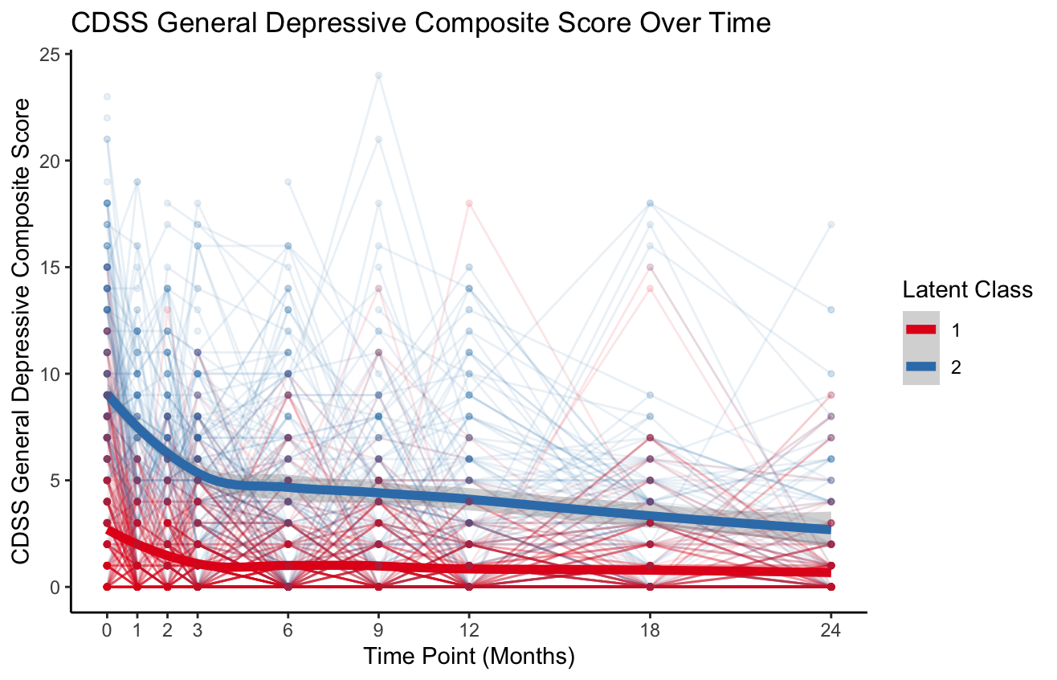
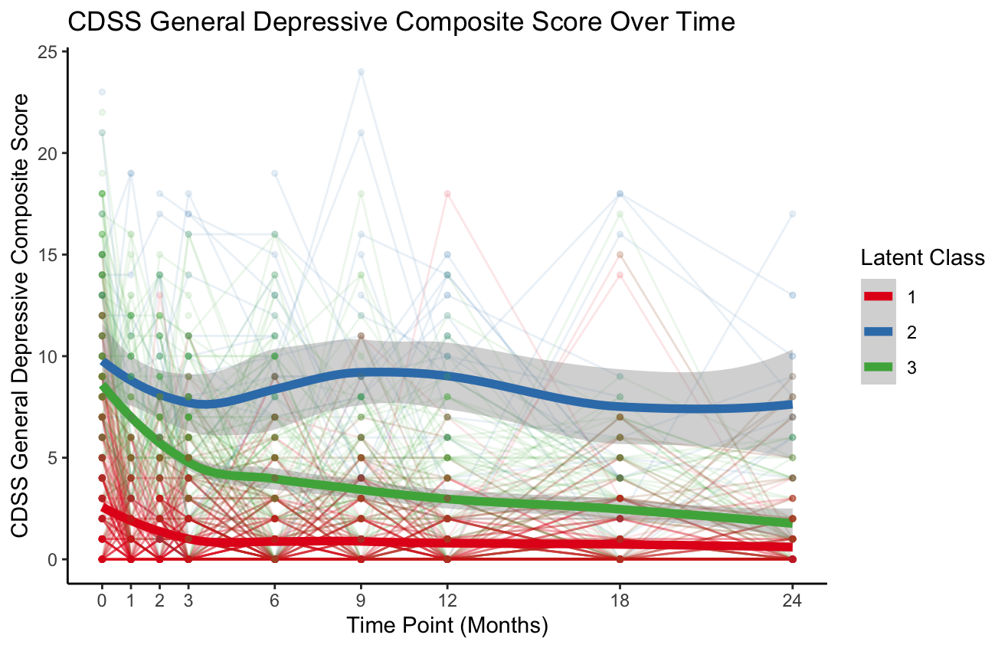
GMM - Total CDSS
Randomized slope AND intercept
(Randomized intercept only would not run for 3 classes)
10
Notes:
GMM3: Loglik: -10288.9, BIC: 20655, Class 1: 25.8%, Class 2: 71.1%, Class 3: 3.1%
GMM4: Has a class that is 0.82%

Slide 11
GMM - Total CDSS
Total: Class 1: 69%, Class 2: 31%
Total: Class 1: 66%, Class 2: 4%, Class 3: 30%
Imaging data:
Class 1: 87 (68%)
Class 2: 40 (32%)
Imaging data:
Class 1: 85 (67%)
Class 2: 4 (3%)
Class 3: 38 (30%)
11
Notes:
GMM3: Loglik: -10288.9, BIC: 20655, Class 1: 25.8%, Class 2: 71.1%, Class 3: 3.1%
GMM4: Has a class that is 0.82%

Slide 12
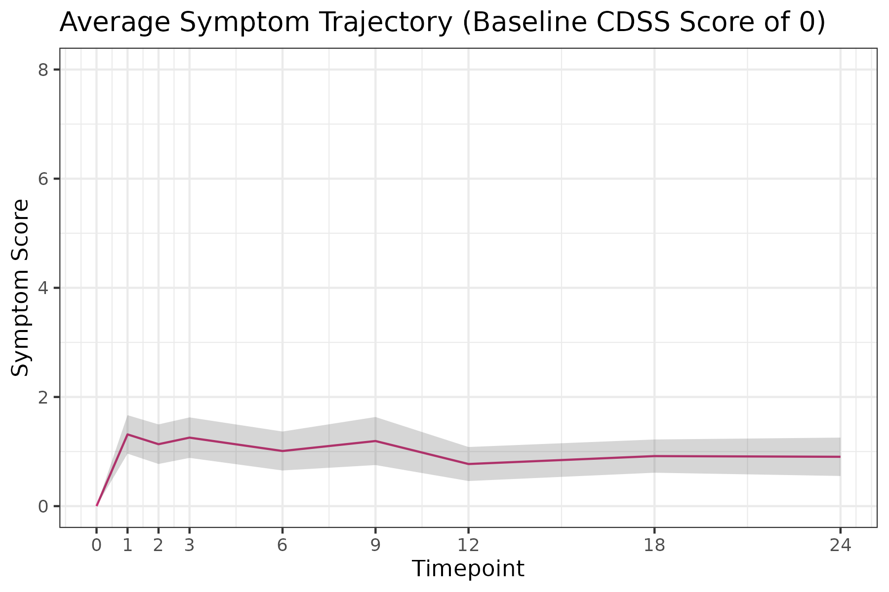
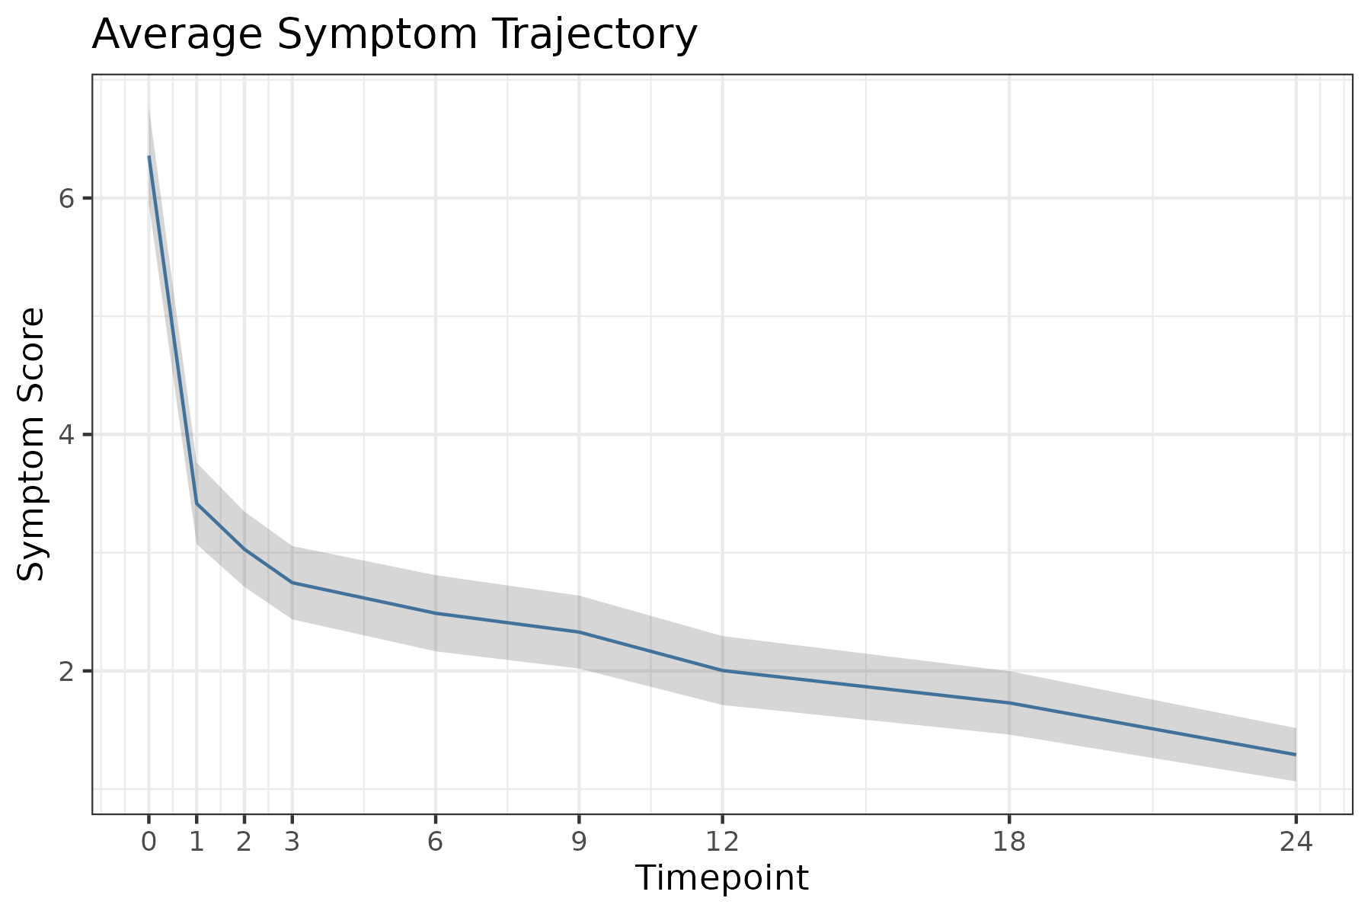
Mean Total CDSS Score Over Time
Red: baseline score of 0, blue: baseline score >0
n=127
21%
n=485
79%
12
Gray is 95% confidence interval
Notes:
4 people that stay at 0 from baseline to 24 months

Slide 13
Mean Total CDSS Score Over Time
Red: baseline score of 0, blue: baseline score >0
n=127
21%
n=485
79%
Imaging data: n=30 (24%)
Imaging data: n=97 (76%)
13
Notes:
4 people that stay at 0 from baseline to 24 months

Slide 14
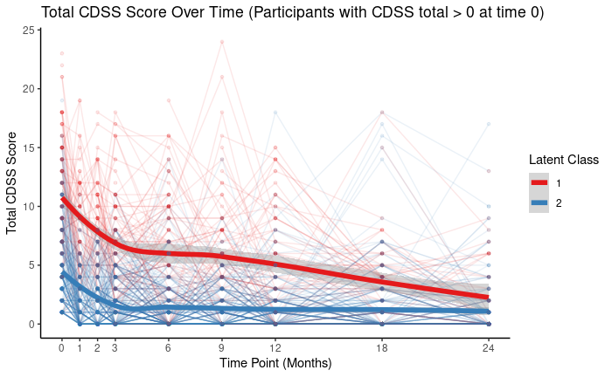
LCGA - Total CDSS
LCGA2 :
BIC: 16993
Class 1: 22% Class 2: 78%
With participants with CDSS of 0 at baseline ^
14

Slide 15
LCGA - Total CDSS
LCGA2 :
BIC: 16993
Class 1: 22% Class 2: 78%
Imaging data:
Class 1: 17 (18%)
Class 2: 80 (82%)
15

Slide 16
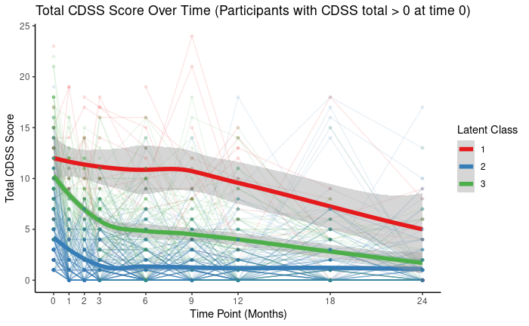
LCGA - Total CDSS
LCGA3 :
BIC: 16920, Class 1: 3%,
Class 2: 74% Class 3: 23%
With participants with CDSS of 0 at baseline ^
16

Slide 17
LCGA - Total CDSS
LCGA3 :
BIC: 16920, Class 1: 3%,
Class 2: 23% Class 3: 74%
Imaging data:
Class 1: 1 (1.1%)
Class 2: 21 (21.6%)
Class 3: 75 (77.3%)
17

Slide 18
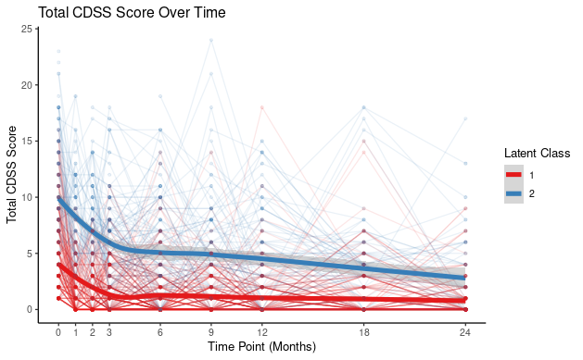
GMM* - Total CDSS
*Random intercept and slope
GMM2:
BIC: 16857
Class 1: 69% Class 2: 31%
With participants with CDSS of 0 at baseline ^
18

Slide 19
GMM* - Total CDSS
*Random intercept and slope
GMM2:
BIC: 16857
Class 1: 69% Class 2: 31%
Imaging data:
Class 1: 69 (71%)
Class 2: 28 (29%)
19

Slide 20
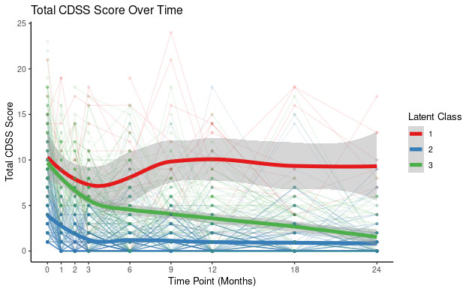
GMM* - Total CDSS
*Random intercept and slope
GMM3:
BIC: 16848, Class 1: 3%,
Class 2: 67% Class 3: 30%
With participants with CDSS of 0 at baseline ^
20

Slide 21
GMM* - Total CDSS
*Random intercept and slope
GMM3:
BIC: 16848, Class 1: 3%,
Class 2: 67% Class 3: 30%
Imaging data:
Class 1: 3 (3%)
Class 2: 66 (68%)
Class 3: 28 (29%)
21

Slide 22
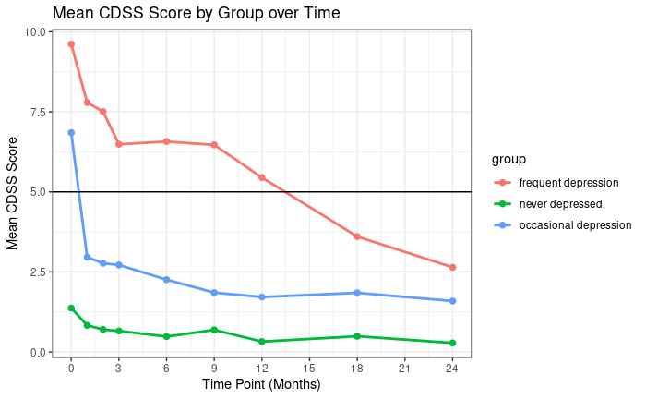
Total:
Frequent n= 75 (12%)
Occasional n =297 (49%)
Never n=240 (39%)
Depression: total CDSS >= 5
Frequent depression: depressed > 3 times
Occasional depression: depressed 1-3 times
Never depressed: depressed 0 times
22

Slide 23
Total:
Frequent n= 75 (12%)
Occasional n =297 (49%)
Never n=240 (39%)
Imaging Data:
Frequent n= 19 (15%)
Occasional n =57 (45%)
Never n=51 (40%)
Depression: total CDSS >= 5
Frequent depression: depressed > 3 times
Occasional depression: depressed 1-3 times
Never depressed: depressed 0 times
23

Slide 24
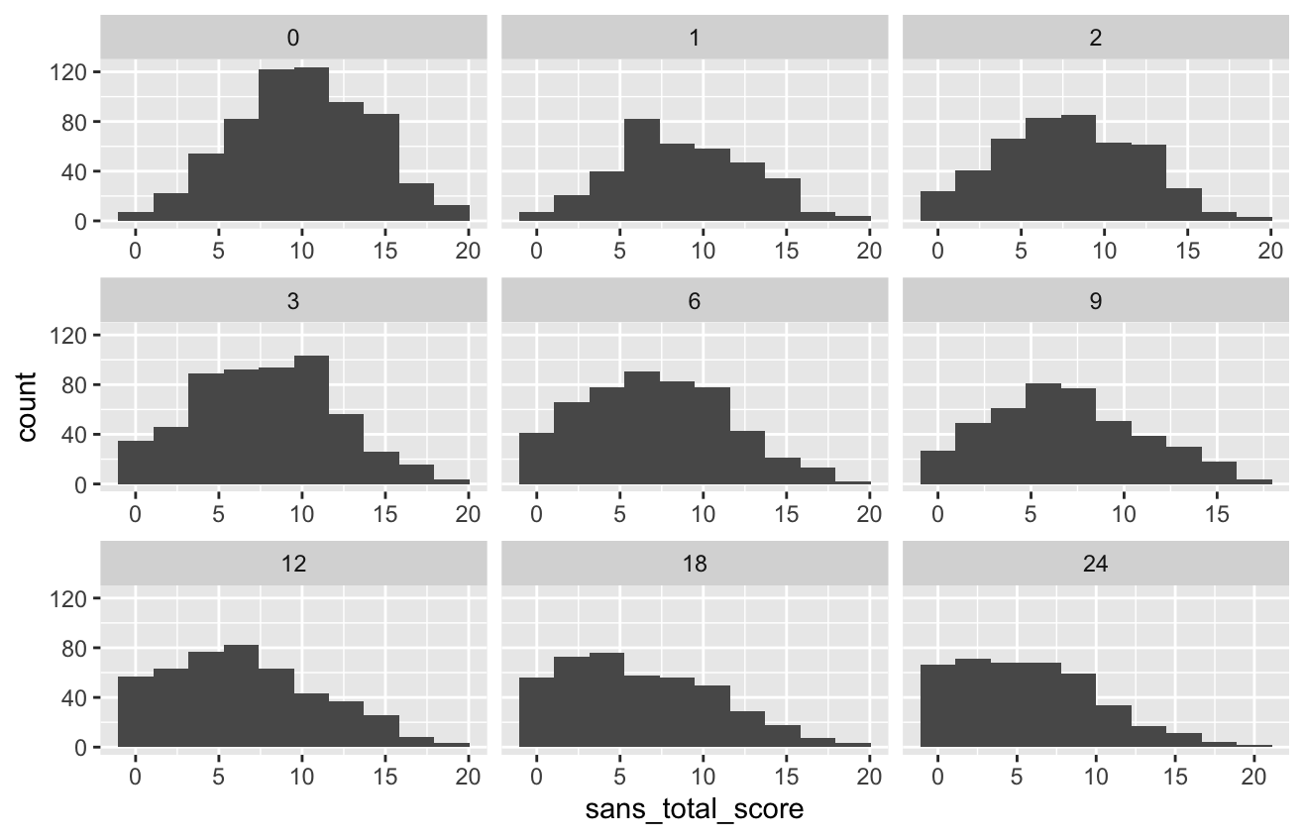
24

Slide 25
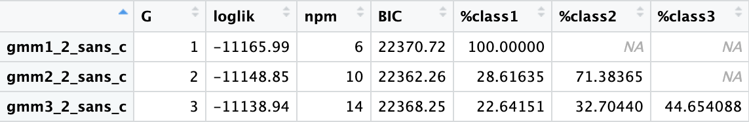
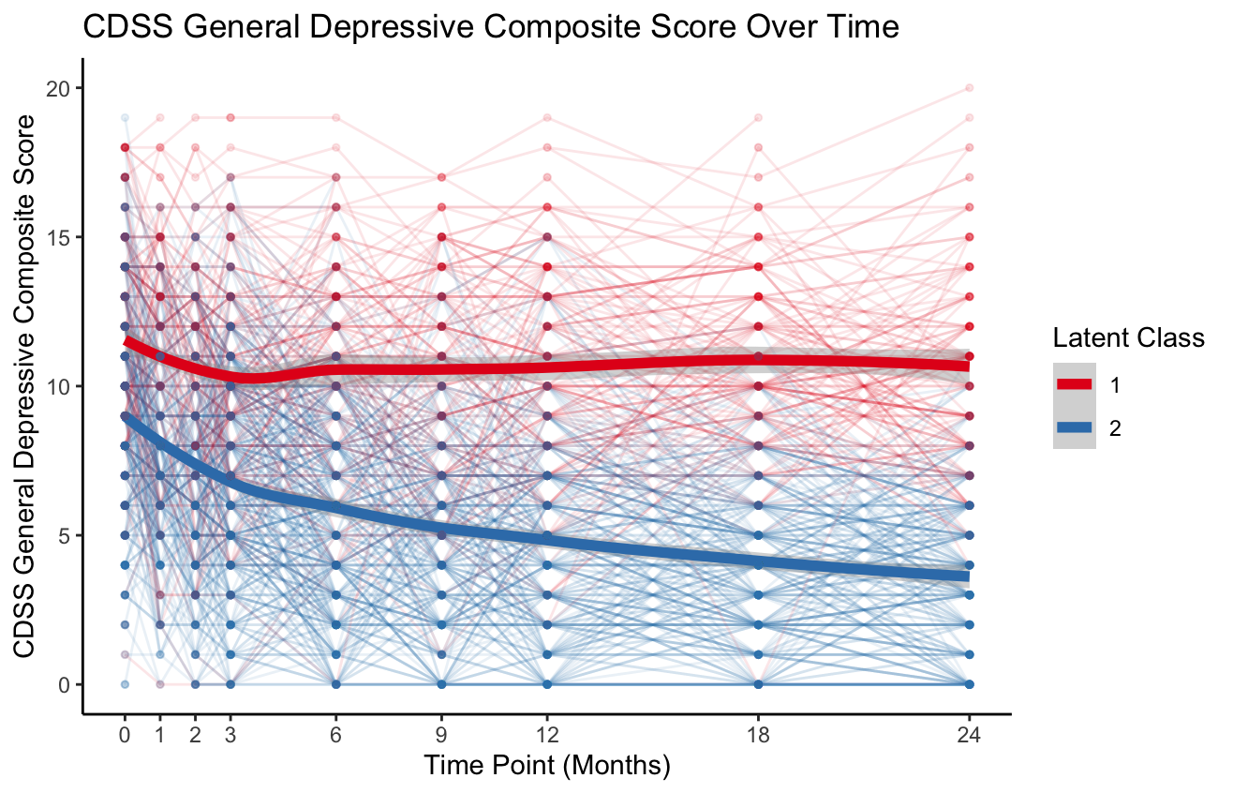
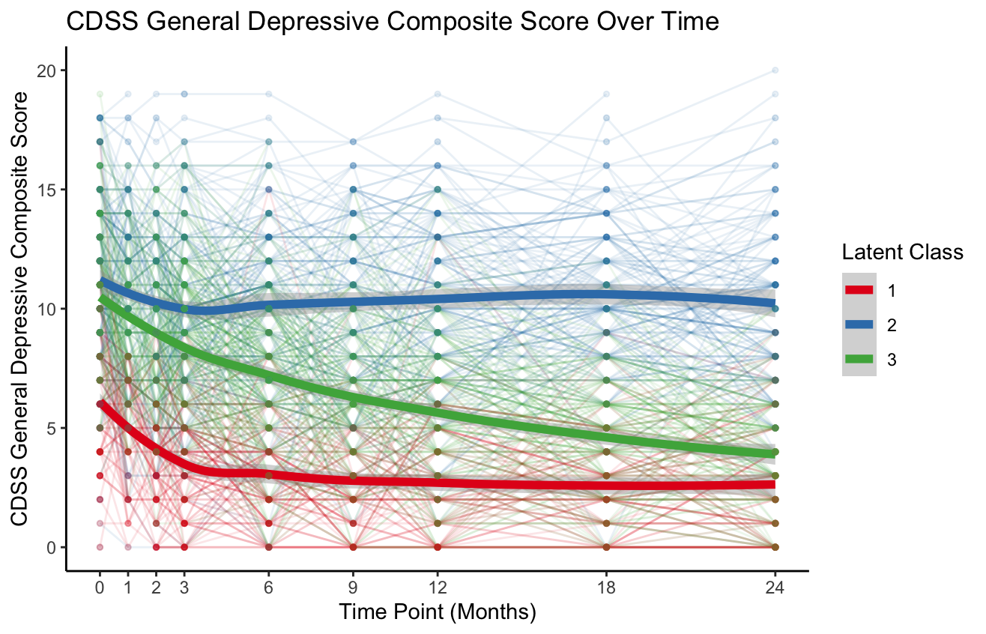
Total SANS
25

Slide 26
Total SANS
Total: Class 1: 29%, Class 2: 71%
Total: Class 1: 22%, Class 2: 33%, Class 3: 45%
Imaging data:
Class 1: 37 (28%)
Class 2: 94 (72%)
Imaging data:
Class 1: 30 (23%)
Class 2: 40 (31%)
Class 3: 61 (46%)
26

Slide 27
# of Classes | BIC | sE | APP Class 1 | APP Class 2 | APP Class 3 | Observed BLRT | p-value
CDSS
2 | 20623.48 | 0.6400 | 0.9034553 | 0.9016539 | / | 2444.239 3-class > 2-class | p < 0.002
3 | 20612.37 | 0.6909 | 0.8990282 | 0.7774365 | 0.8120851
SANS
2 | 22362.26 | 0.5390 | 0.8240607 | 0.8765274 | / | -61.2329 2-class > 3-class | p = 0.962
3 | 22368.25 | 0.4734 | 0.6720170 | 0.8118333 | 0.7178472
LV1
2 | 17897.61 | 0.6571 | 0.9033564 | 0.9197520 | / | 2466.301 3-class > 2-class | p < 0.002
3 | 17896.63 | 0.7487 | 0.8648044 | 0.9096705 | 0.8608580
SOFAS
2 | 9430.636 | 0.6047 | 0.8659344 | 0.8910901 | / | 321.2414 3-class > 2-class | p < 0.002
3 | 9453.943 | 0.4231 | 0.8394948 | 0.5420992 | 0.6711560
Bayesian Information Criterion (BIC): Lower BIC indicates a better balance between model fit and complexity
Scaled Entropy (sE): Higher (closer to 1) sE means clearer and more confidence when assigning participants to their classes
Average Posterior Probabilities (APP): Higher APP (close to 1) means individuals are better classified into that class. Literature suggests a value >0.8 as a cutoff.
Bootstrap Likelihood Ratio Test (BLRT):
Null hypothesis: 2-class better than 3-class. Alternative hypothesis: 2-class NOT better than 3-class
Positive BLRT value indicates reject null (3-class better than 2-class)
Negative BLRT value indicates fail to reject null (2-class better than 3-class)
27

Slide 28
# of Classes | BIC | sE | APP Class 1 | APP Class 2 | APP Class 3 | Observed BLRT | p-value
CDSS
2 | 20623.48 | 0.6400 | 0.9034553 | 0.9016539 | / | 2444.239 3-class > 2-class | p < 0.002
3 | 20612.37 | 0.6909 | 0.8990282 | 0.7774365 | 0.8120851
SANS
2 | 22362.26 | 0.5390 | 0.8240607 | 0.8765274 | / | -61.2329 2-class > 3-class | p = 0.962
3 | 22368.25 | 0.4734 | 0.6720170 | 0.8118333 | 0.7178472
LV1
2 | 17897.61 | 0.6571 | 0.9033564 | 0.9197520 | / | 2466.301 3-class > 2-class | p < 0.002
3 | 17896.63 | 0.7487 | 0.8648044 | 0.9096705 | 0.8608580
SOFAS
2 | 9430.636 | 0.6047 | 0.8659344 | 0.8910901 | / | 321.2414 3-class > 2-class | p < 0.002
3 | 9453.943 | 0.4231 | 0.8394948 | 0.5420992 | 0.6711560
28

Slide 29
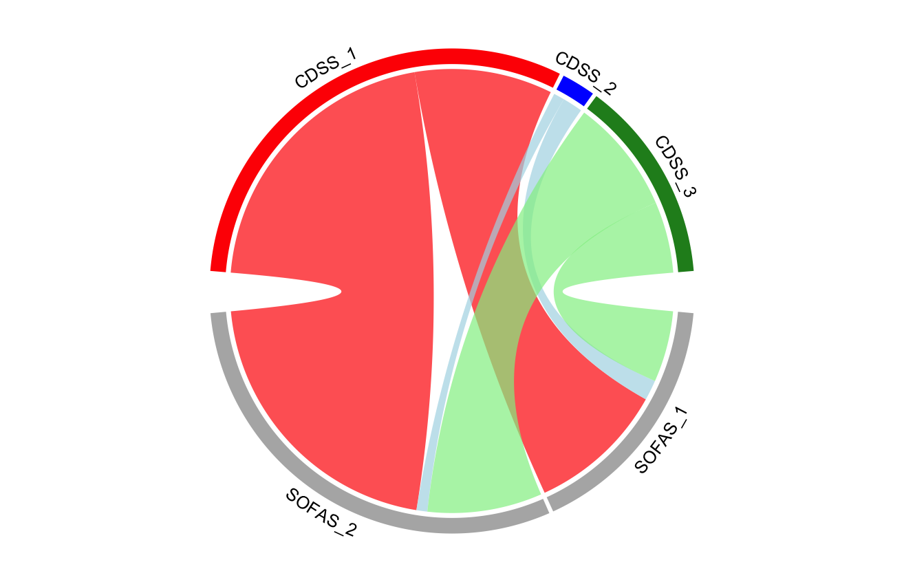
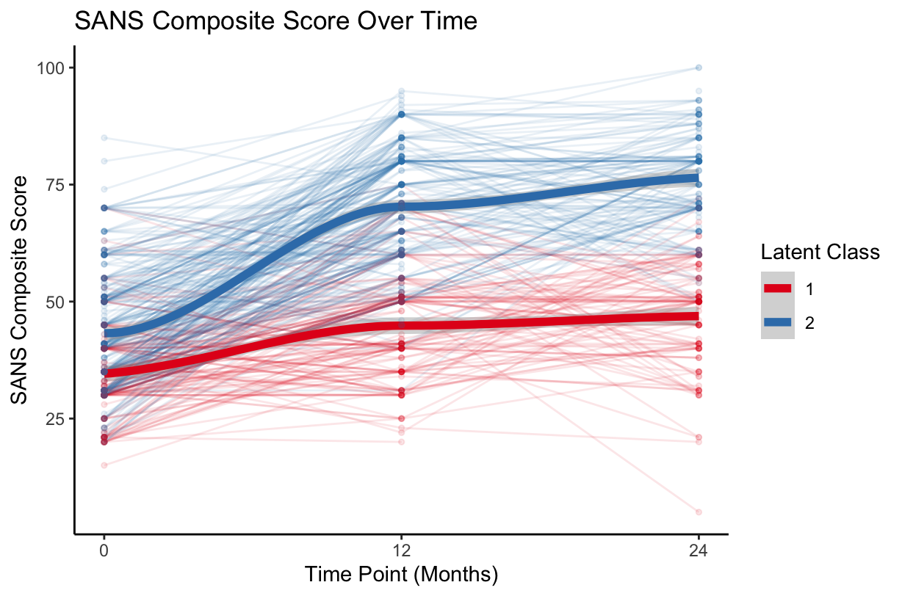
CDSS (3-class) vs SOFAS (2-class)
35.0%
68.63%
4.41%
65.0%
32.4%
CDSS Composite Score
67.6%
61.7%
30.06%
38.3%
31.1%
SOFAS_2
8.8%
SOFAS Composite Score
69.7%
60.1%
36.24%
SOFAS_1
27.7%
63.76%
29
2.6%

Slide 30
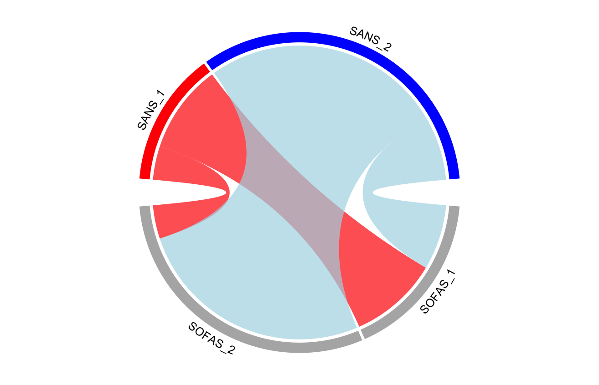
SANS (2-class) vs SOFAS (2-class)
71.38%
78.6%
28.62%
SANS Composite Score
72.6%
21.4%
27.4%
12.3%
42.3%
SOFAS_2
SOFAS Composite Score
57.7%
36.24%
87.7%
SOFAS_1
63.76%
30

Slide 31
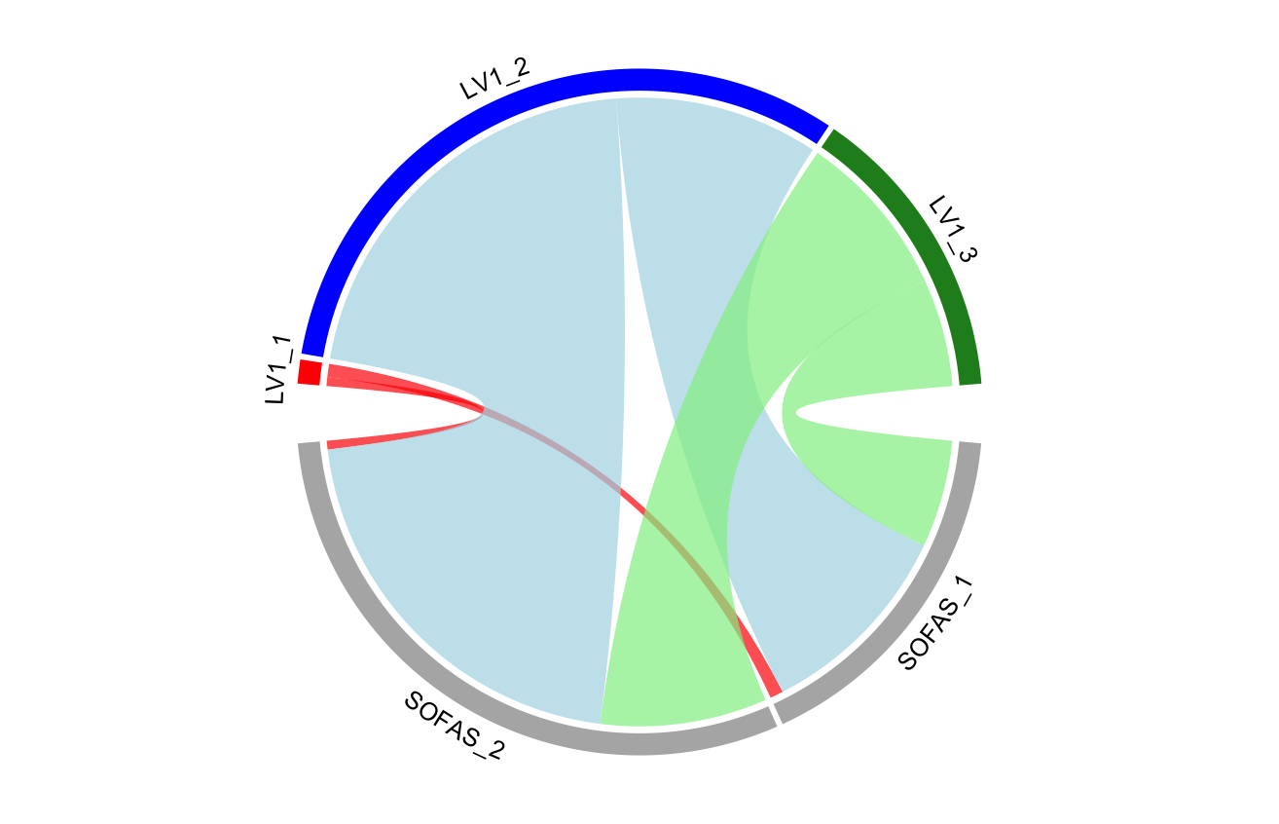
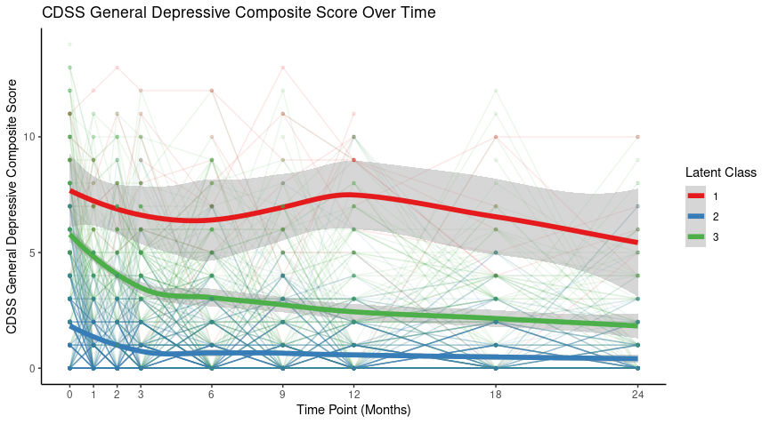
LV1 (3-class) vs SOFAS (2-class)
65.85%
LV1 (2-class) vs SOFAS (2-class)
33.2%
66.8%
60.8%
31.86%
60.0%
2.29%
39.2%
40.0%
1.5%
33.1%
SOFAS_2
SOFAS Composite Score
70.0%
62.8%
36.24%
SOFAS_1
30.0%
63.76%
4.1%
31

Slide 32
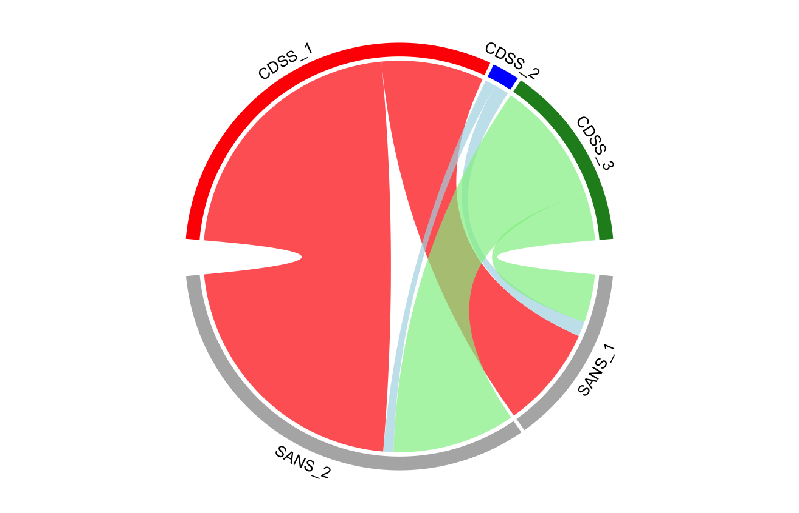
CDSS (3-class) vs SANS (2-class)
40.7%
68.63%
4.41%
59.3%
27.5%
CDSS Composite Score
30.06%
72.5%
71.7%
28.3%
29.2%
9.0%
67.0%
61.8%
SANS Composite Score
28.62%
30.5%
71.38%
2.5%
32

Slide 33
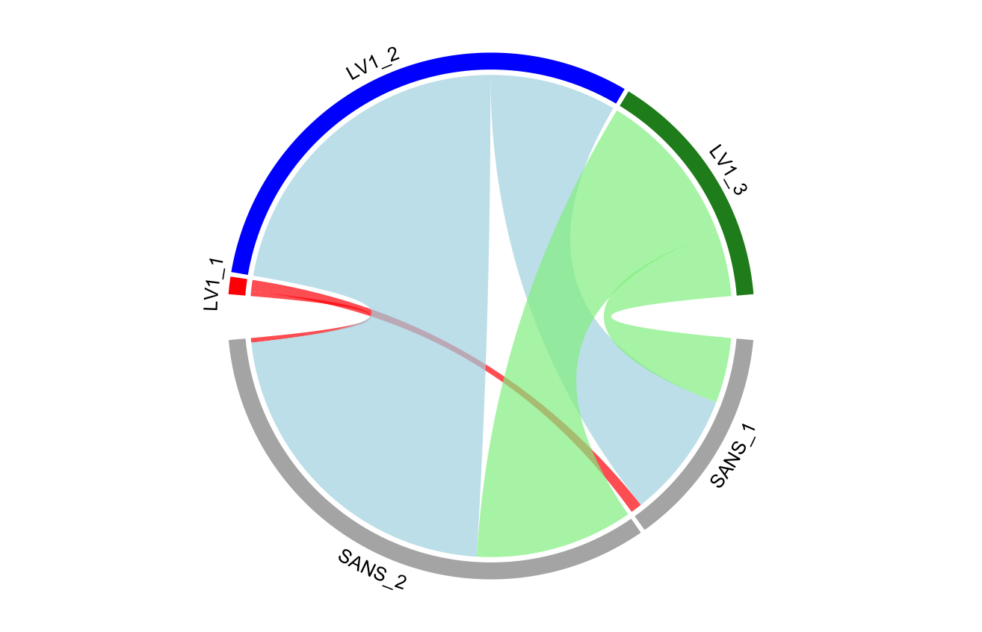
LV1 (3-class) vs SANS (2-class)
65.85%
27.6%
72.4%
31.86%
71.4%
70.8%
2.29%
29.2%
28.6%
32.0%
0.9%
67.2%
62.4%
SANS Composite Score
28.62%
31.9%
5.6%
71.38%
33

Slide 34
Summary
Additional statistics suggest:
3 class GMM for CDSS and LV1
2 class GMM for SANS and SOFA
Thoughts on cut-off approach?
34

Slide 35
Appendix
Additional diagrams
Total CDSS
Histogram Total CDSS at 18 Months
Histogram # of Depressed Timepoints
Membership Change Diagram Total CDSS LCGA
LV1
GMM2 2- and 3-class trajectories
Histogram of LV1 at Baseline
LV2
Histogram of LV2 at Baseline
LV3
Histogram of LV3 at Baseline
SOFAS
GMM2 2- and 3-class trajectories
Additional Cutoff Figures
Depression defined as >=4
Frequent depression defined as > 4
Depressive/Negative Vs SOFAS
CDSS (2-class) vs SOFAS (2-class)
CDSS (2-class) vs SOFAS (3-class)
CDSS (3-class) vs SOFAS (3-class)
SANS (2-class) vs SOFAS (3-class)
SANS (3-class) vs SOFAS (2-class)
SANS (3-class) vs SOFAS (3-class)
LV1 (2-class) vs SOFAS (2-class)
LV1 (2-class) vs SOFAS (3-class)
LV1 (3-class) vs SOFAS (3-class)
Depressive vs Negative
CDSS (2-class) vs SANS (2-class)
CDSS (2-class) vs SANS (3-class)
CDSS (3-class) vs SANS (3-class)
LV1 (2-class) vs SANS (2-class)
LV1 (2-class) vs SANS (3-class)
LV1 (3-class) vs SANS (3-class)

Slide 36
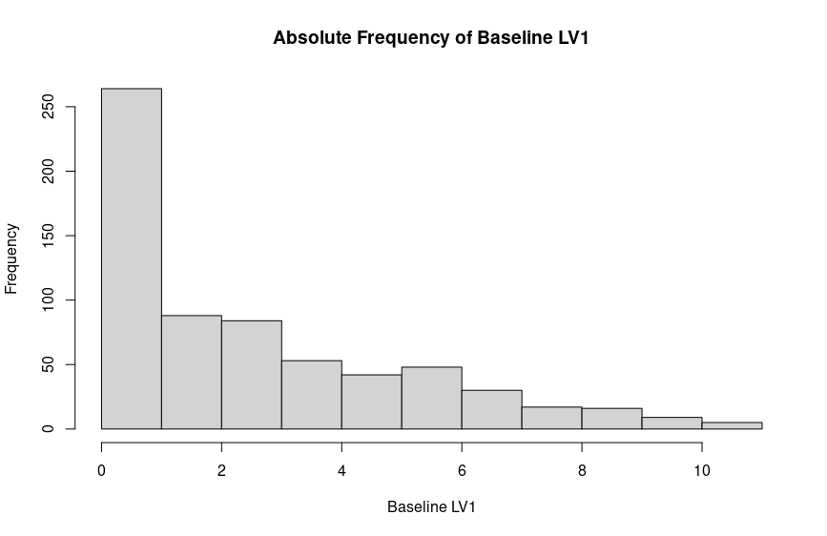

Slide 37
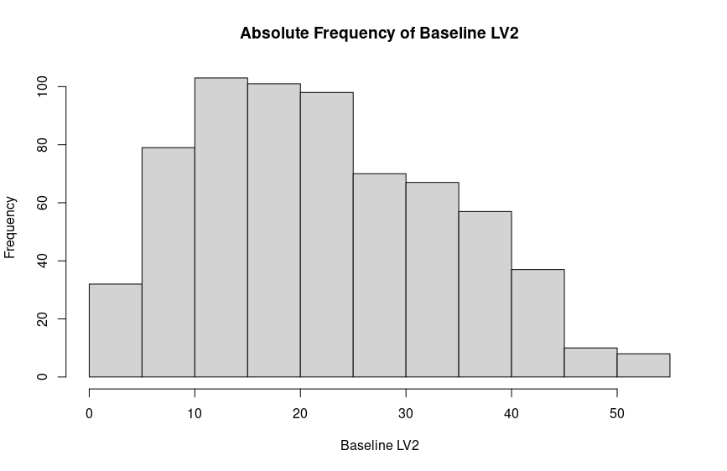
5

Slide 38
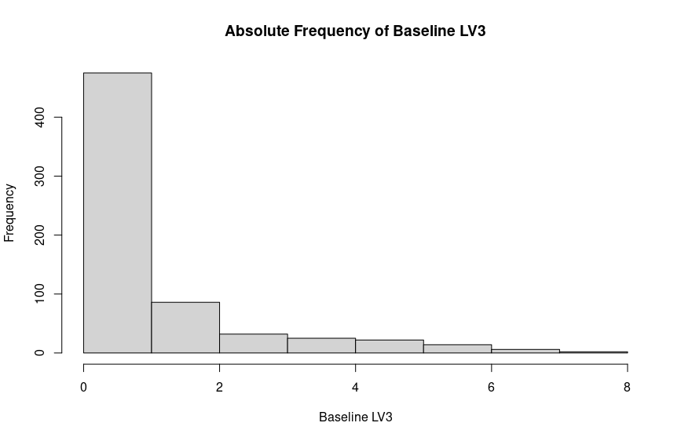
S2

Slide 39
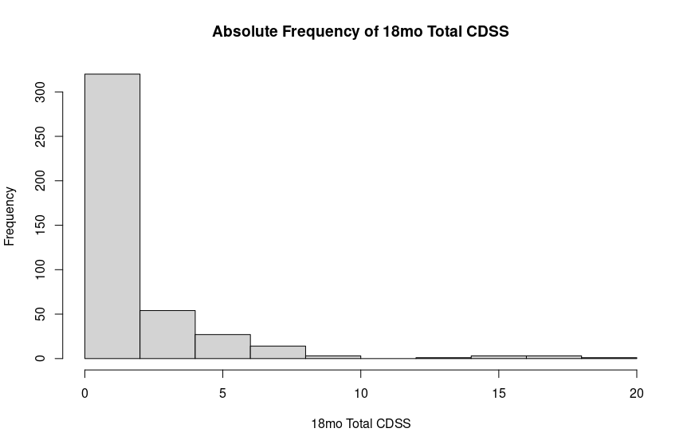
Mean: 1.6 Median: 0 Range: 0-18. 243 out of 409 = 0 (59%)
S1

Slide 40
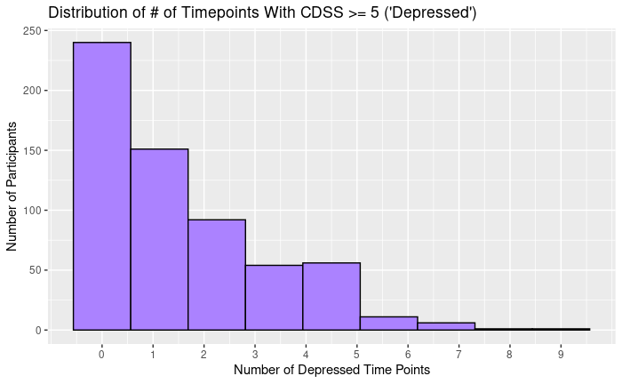
S2
Notes:
1 person was depressed at all timepoints

Slide 41
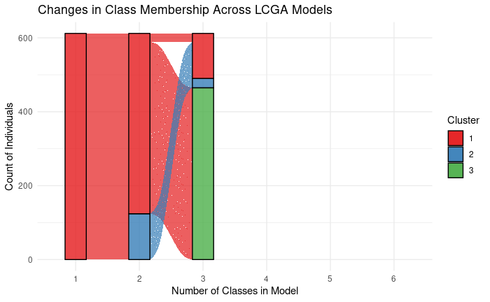
6

Slide 42
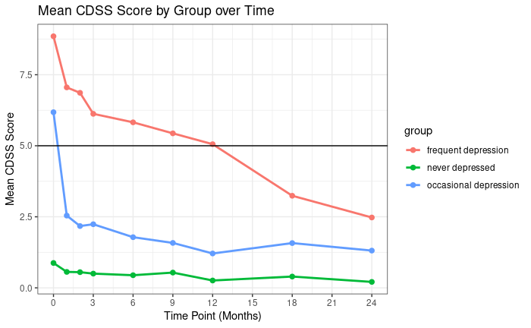
Frequent depression: 102 (16.7%)
Occasional depression: 327 (53.4%)
No depression: 183 (29.9%)
Depression: total CDSS >= 4
Frequent depression: depressed > 3 times
Occasional depression: depressed 1-3 times
Never depressed: depressed 0 times
6

Slide 43
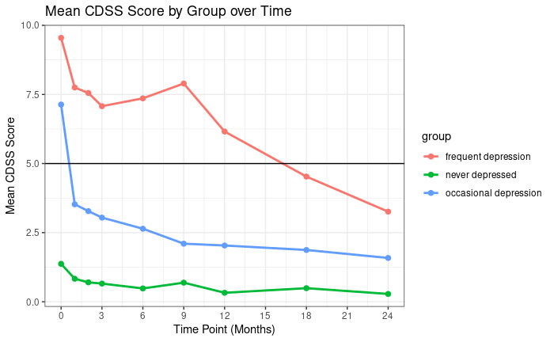
Frequent depression: 42 (3.9%)
Occasional depression: 330 (53.9%)
No depression: 240 (39.2%)
Depression: total CDSS >= 5
Frequent depression: depressed > 4 times
Occasional depression: depressed 1-4 times
Never depressed: depressed 0 times
6

Slide 44
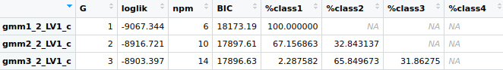
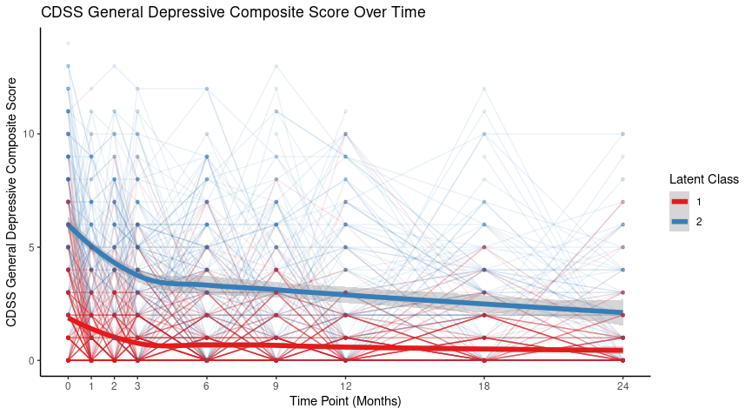

Slide 45
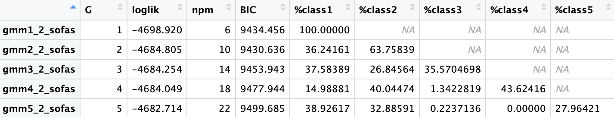
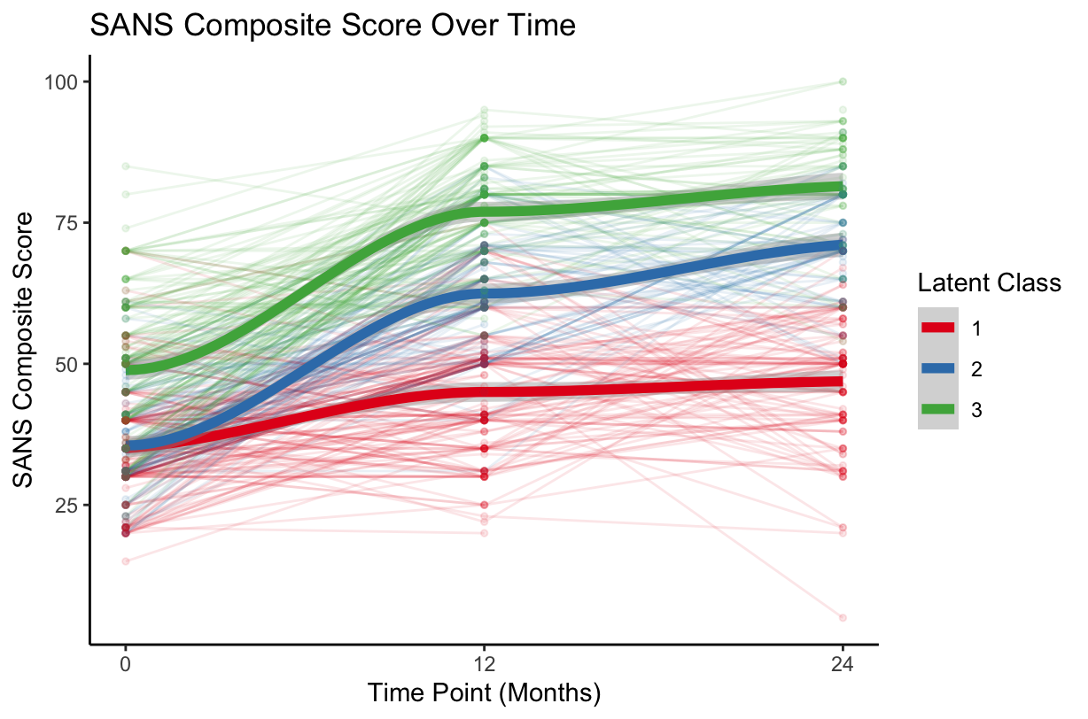
SOFAS Composite Score

Slide 46
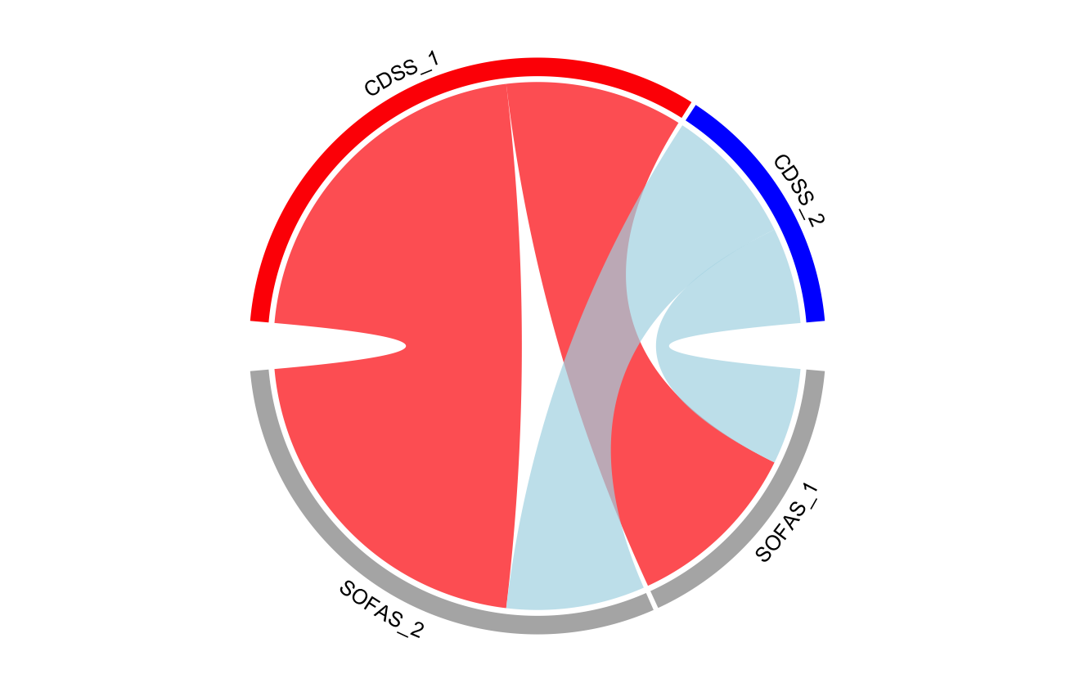
CDSS (2-class) vs SOFAS (2-class)
68.63%
33.3%
CDSS Composite Score
66.7%
59.1%
31.37%
40.9%
35.1%
SOFAS_2
SOFAS Composite Score
71.9%
64.9%
36.24%
SOFAS_1
28.1%
63.76%

Slide 47
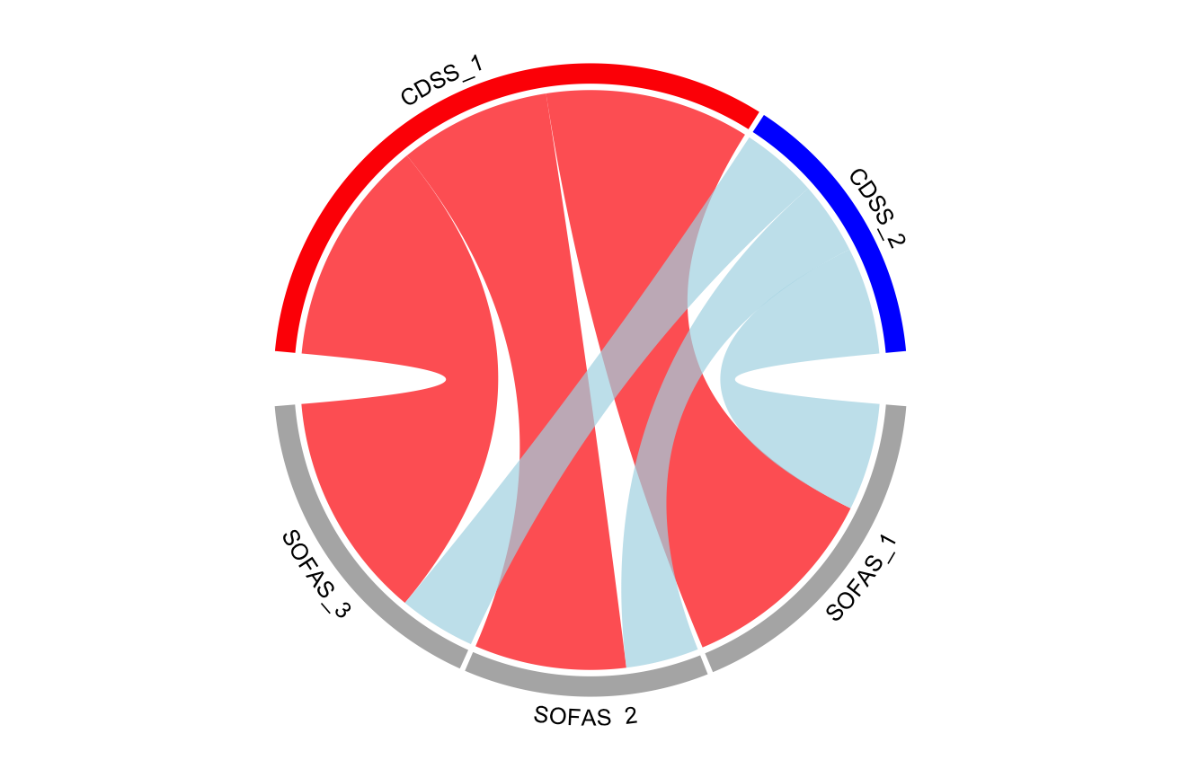
CDSS (2-class) vs SOFAS (3-class)
68.63%
35.1%
26.0%
CDSS Composite Score
29.9%
31.37%
38.9%
28.4%
41.7%
34.4%
SOFAS_3
74.7%
SOFAS Composite Score
SOFAS_2
65.6%
35.58%
25.3%
37.58%
SOFAS_1
67.6%
32.4%
26.85%

Slide 48
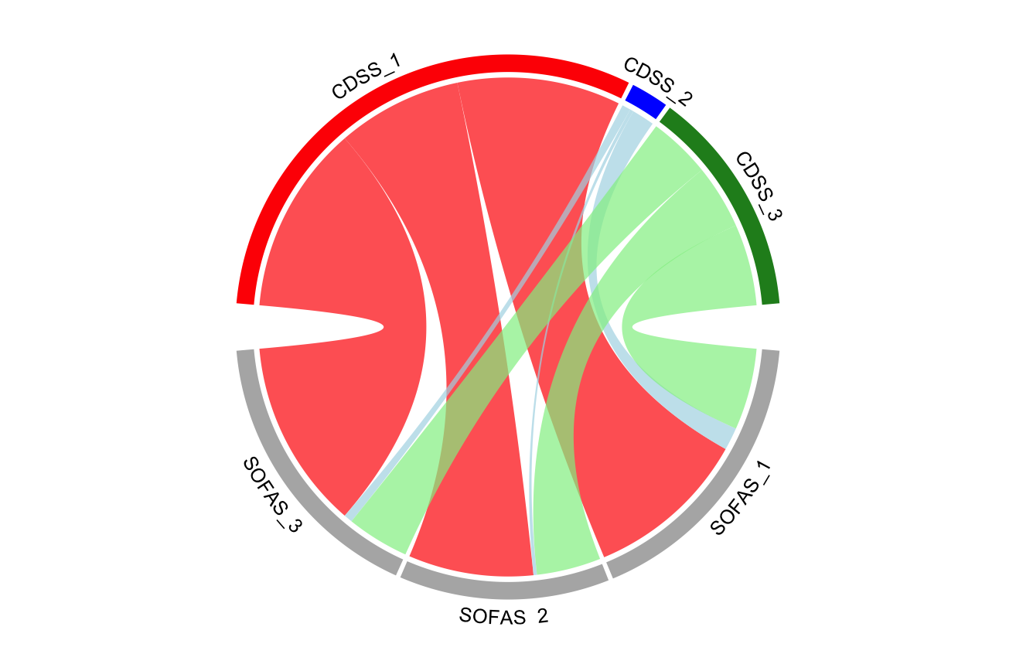
CDSS (3-class) vs SOFAS (3-class)
25.0%
10.0%
68.63%
4.41%
65.0%
34.2%
26.2%
CDSS Composite Score
30.0%
30.06%
30.8%
39.6%
39.2%
30.5%
SOFAS_3
72.7%
8.5%
SOFAS Composite Score
SOFAS_2
61.0%
35.58%
24.0%
37.58%
SOFAS_1
64.9%
3.3%
1.8%
26.85%

Slide 49
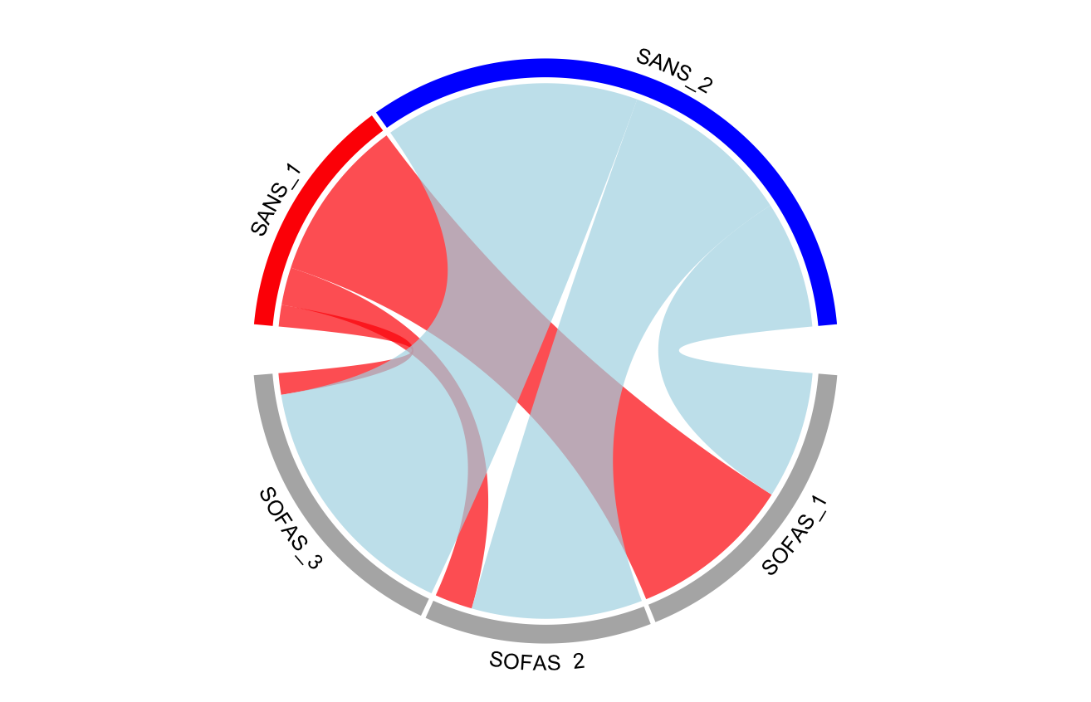
SANS (2-class) vs SOFAS (3-class)
71.38%
46.1%
28.62%
30.8%
SANS Composite Score
73.4%
16.9%
23.1%
9.7%
7.8%
43.8%
SOFAS_3
92.2%
SOFAS Composite Score
SOFAS_2
56.2%
35.58%
37.58%
SOFAS_1
81.9%
18.1%
26.85%

Slide 50
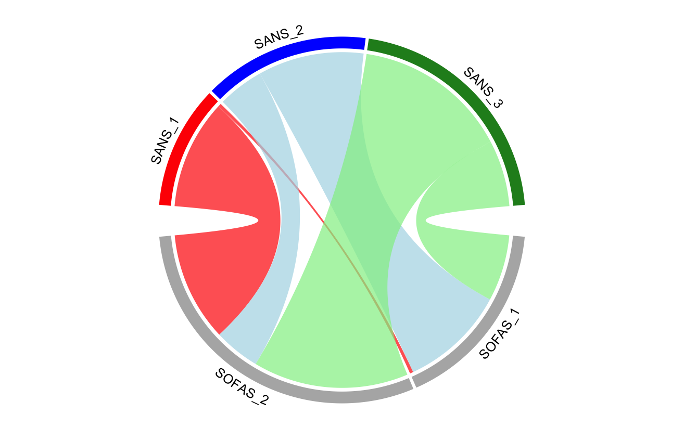
SANS (3-class) vs SOFAS (2-class)
32.70%
3.0%
69.6%
44.65%
SANS Composite Score
30.4%
70.1%
22.64%
97.0%
29.9%
37.8%
35.1%
SOFAS_2
SOFAS Composite Score
60.3%
14.9%
36.24%
SOFAS_1
50.0%
63.76%
1.9%

Slide 51
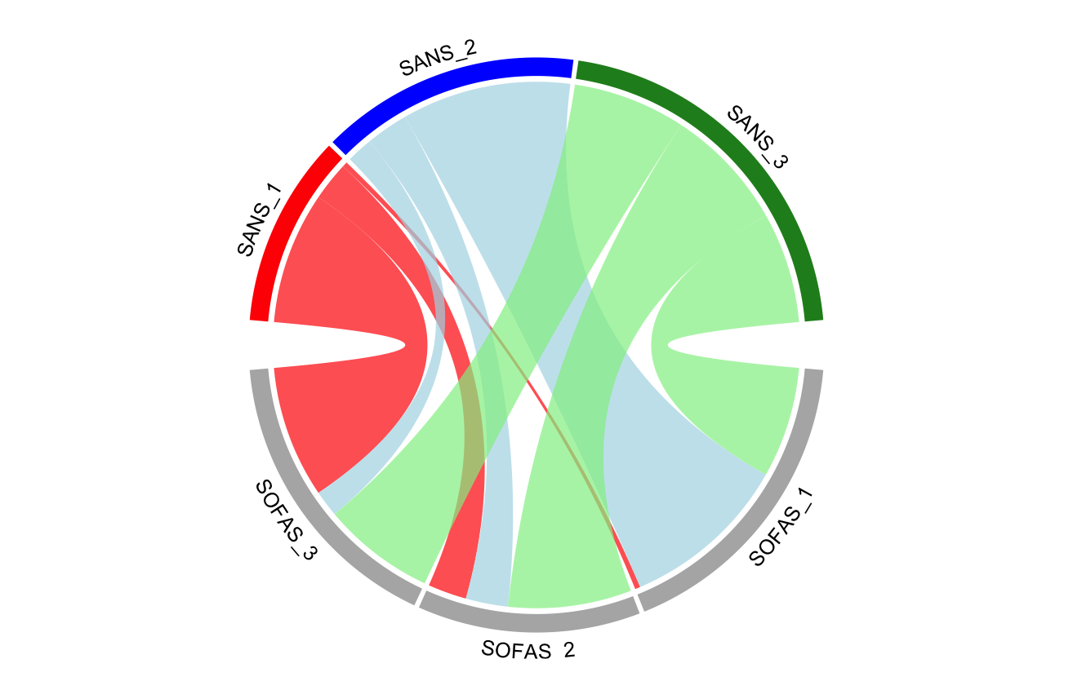
SANS (3-class) vs SOFAS (3-class)
32.70%
11.1%
3.0%
71.1%
32.5%
44.65%
SANS Composite Score
17.8%
22.64%
22.0%
35.5%
75.0%
32.0%
41.6%
38.9%
SOFAS_3
SOFAS Composite Score
SOFAS_2
59.2%
48.7%
37.58%
35.58%
SOFAS_1
20.7%
60.3%
9.7%
19.0%
1.9%
26.85%

Slide 52

LV1 (2-class) vs SOFAS (2-class)
LV1 (3-class) vs SOFAS (2-class)
67.16%
32.6%
67.4%
38.24%
57.7%
42.3%
37.2%
SOFAS_2
SOFAS Composite Score
71.9%
62.8%
36.24%
SOFAS_1
28.1%
63.76%

Slide 53

LV1 (2-class) vs SOFAS (3-class)
67.16%
34.4%
26.3%
29.2%
38.24%
27.7%
39.3%
43.1%
36.4%
SOFAS_3
74.7%
SOFAS Composite Score
SOFAS_2
63.6%
35.58%
25.3%
37.58%
SOFAS_1
67.6%
32.4%
26.85%

Slide 54
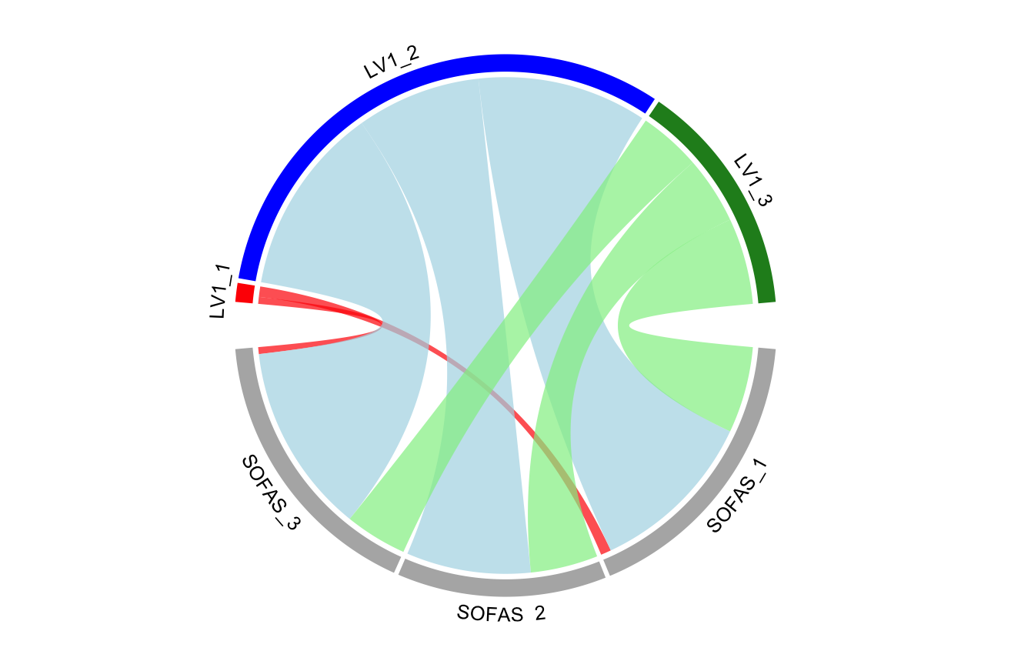
LV1 (3-class) vs SOFAS (3-class)
65.85%
25.7%
35.0%
28.8%
31.86%
60.0%
39.3%
31.2%
2.29%
40.0%
40.0%
2.7%
32.5%
SOFAS_3
73.3%
SOFAS Composite Score
SOFAS_2
63.6%
35.58%
24.0%
37.58%
SOFAS_1
64.9%
35.1%
3.9%
26.85%

Slide 55
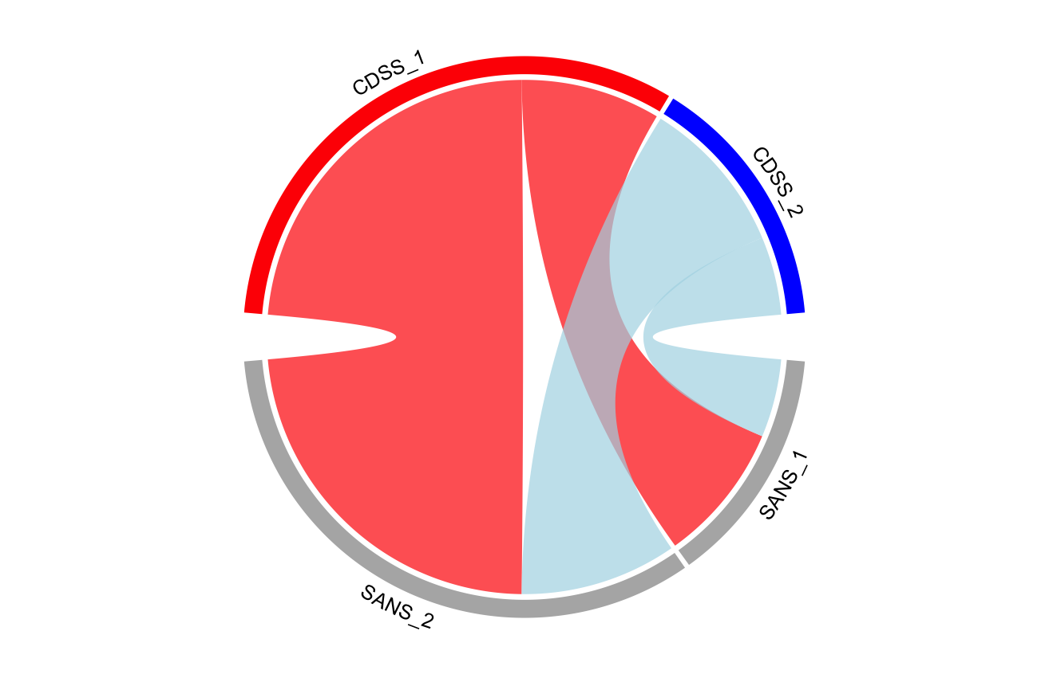
CDSS (2-class) vs SANS (2-class)
68.63%
27.2%
CDSS Composite Score
31.37%
72.8%
66.7%
33.3%
36.0%
70.4%
64.0%
SANS Composite Score
28.62%
SANS_1
29.6%
SANS_2
71.38%

Slide 56
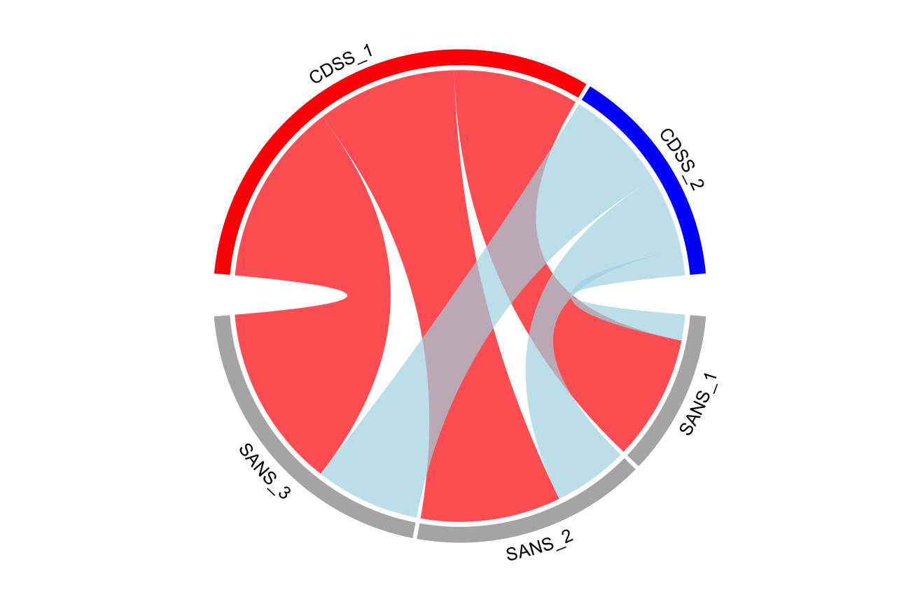
CDSS (2-class) vs SANS (3-class)
68.63%
27.9%
31.3%
CDSS Composite Score
51.0%
31.37%
40.8%
36.5%
12.5%
17.0%
63.6%
83.0%
SANS Composite Score
22.64%
SANS_2
34.8%
36.4%
44.65%
65.2%
SANS_3
SANS_1
32.70%

Slide 57
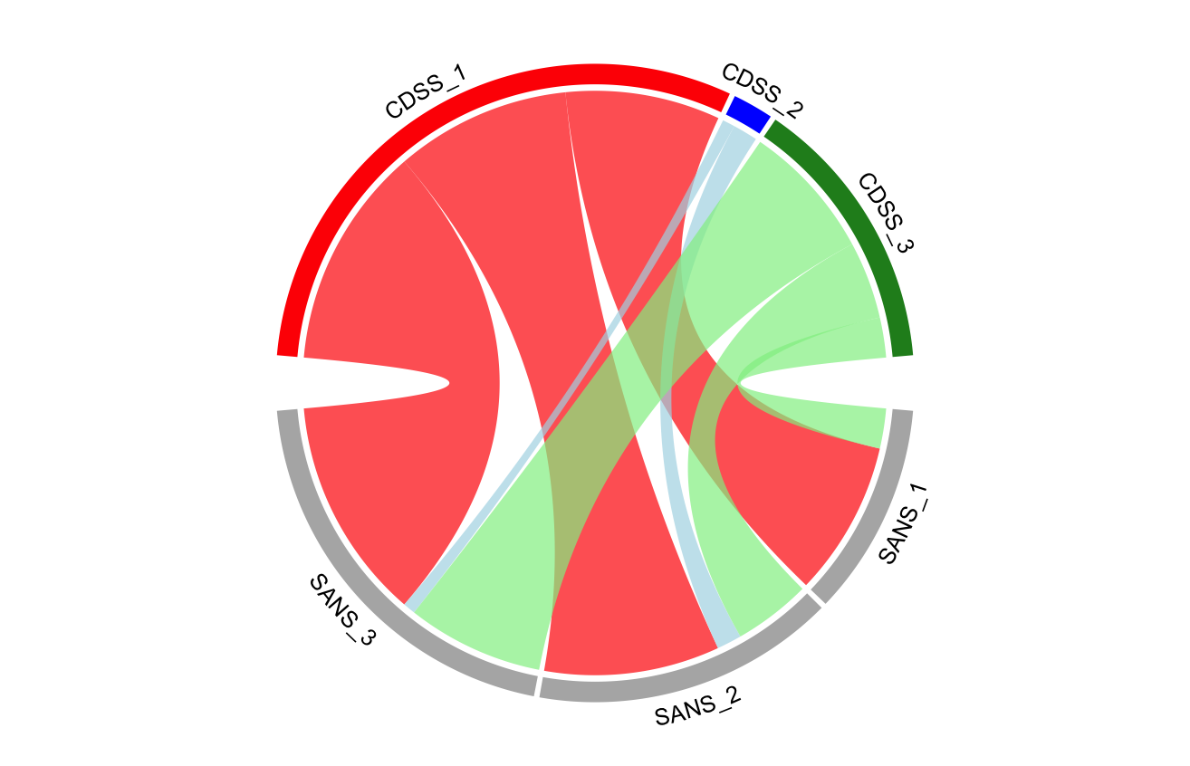
CDSS (3-class) vs SANS (3-class)
33.3%
68.63%
4.41%
66.7%
28.0%
31.8%
CDSS Composite Score
30.06%
53.8%
40.2%
30.4%
15.8%
20.6%
59.9%
79.4%
SANS Composite Score
22.64%
SANS_2
27.8%
36.8%
44.65%
63.2%
SANS_3
3.3%
9.0%
SANS_1
32.70%

Slide 58
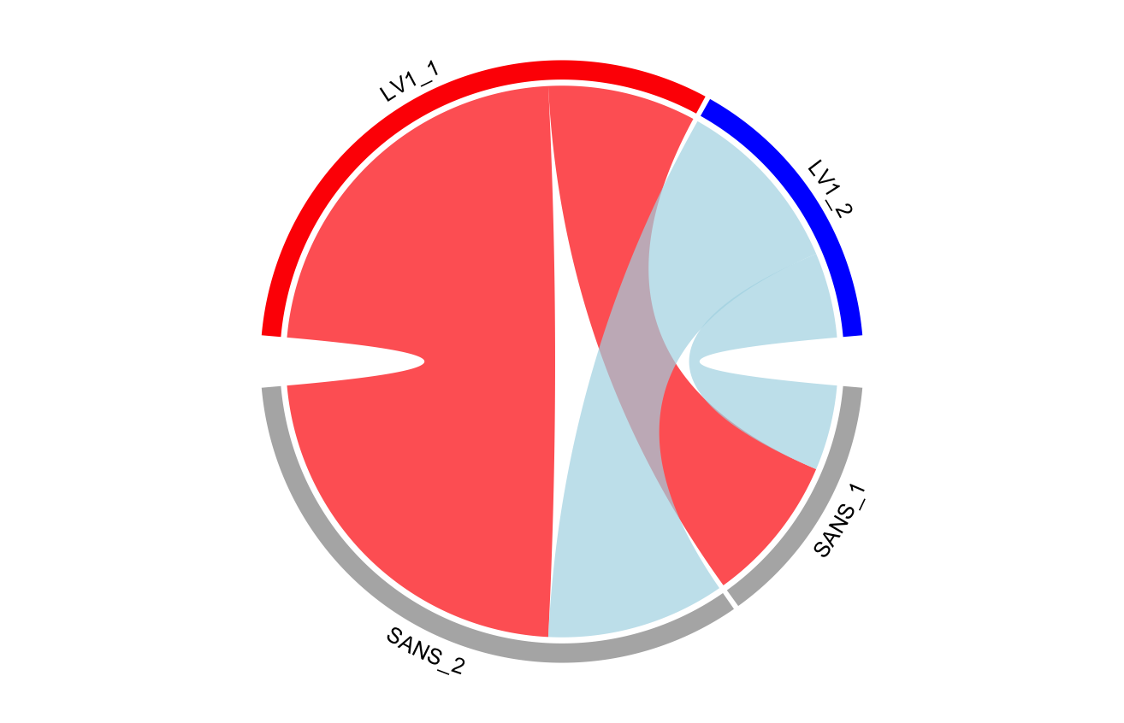
LV1 (2-class) vs SANS (2-class)
67.16%
27.6%
38.24%
72.4%
67.7%
32.3%
36.5%
68.6%
63.5%
SANS Composite Score
28.62%
SANS_1
31.4%
SANS_2
71.38%

Slide 59

LV1 (2-class) vs SANS (3-class)
67.16%
31.7%
27.1%
49.8%
38.24%
41.2%
35.3%
14.9%
21.3%
62.8%
78.7%
SANS Composite Score
22.64%
SANS_2
35.3%
37.2%
64.7%
44.65%
SANS_3
SANS_1
32.70%

Slide 60

LV1 (3-class) vs SANS (3-class)
65.85%
31.8%
26.9%
51.3%
31.86%
78.6%
41.3%
31.8%
2.29%
16.9%
21.4%
23.4%
1.1%
61.7%
76.6%
SANS Composite Score
22.64%
SANS_2
30.8%
37.2%
63.7%
44.65%
SANS_3
SANS_1
5.5%
32.70%

